Slide 1

A presentation on……. Cse : 100
A Presentation on Software Development Project….
Course : CSE-100
…..
Lets start……………………………..

Slide 2
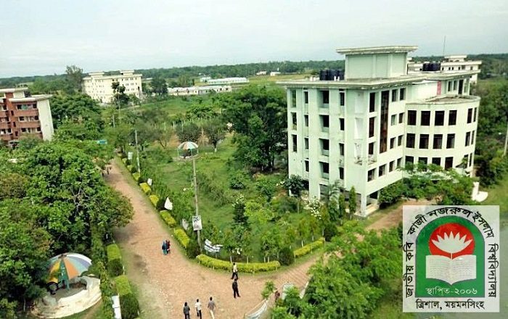
PRESENTATION :
Course : CSE-100.
SESSION : 2016-17.
DEPARTMENT : C.S.E.
Supervised By: Kazi Mahmudul Hassan.
Project Name : Finding out the Telephone Bill of Customers with security access.

Slide 3
INTRODUCTION :
Name: MD. MONTASIR AMIN.
Roll:17102033
Name: MOSTAFA AHMED AN-NUR
Roll: 17102024

Slide 4
LET’S BEGIN :

Slide 5
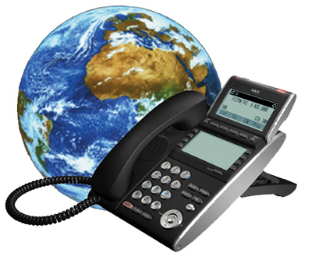
INTRODUCTION :
Since last century, Telephone is performing a great job in our everyday’s communicative-life. At present, along with a few Mobile Network Operators i.e.: GRAMEENPHONE, BANGLALINK, ROBI etc there are also some Fixed line network operators i.e.: BANGLA PHONE, TELEBARTA, RanksTel, BIJOY PHONE etc.”Finding out the Telephone Bill of Customers with Security Access” is the project that helps us to calculate individual customer’s total call duration of a specific month after granting correct username and password.

Slide 6
INTRODUCTION :
It also calculates the cost of total call in Taka considering the monthly rent and also the vat. It is also to be noted that, while executing the software it shows us the current time and date. Finally after taking all input values that relevant to the customer it shows us the exact total amount that the customer have to pay for that month.
Whenever any illegal user or customer enters any wrong or invalid data the program shows him error and asks for the valid information again. This program can count maximum Customer no: 1000000’s individual calculation and each type of the minute type should not exceed up to 100000 minutes. In the approach of customer name and address each string should not exceed 10 characters and Telephone number should take only the last 8 digits associated with RanksTel operator.
Pre-provided data values are as follows:
Monthly rent: 100Tk; LOCAL call rate: 1.5Tk/min; ISD call rate: 6.0Tk/min; NWD call rate: 1.5Tk/min; VAT: 30% of total cost.

Slide 7
Objectives :
Manually it is very difficult to calculate the total minute of a telephone bill along with individual customer’s relevant information and total cost of the customer counting the monthly rent and vat. With the help of computer it becomes easy and faster to manage the system. In this project, it is the facilities to take all information and calculate a customer’s specific month total Telephone bill calculation in the system. The main objective of the system is which target to put a security to the user of the software and calculate his monthly total Telephone bill.

Slide 8

Background Study :
In distance wireless communication there are two types of device. Mobile network operator and Fixed line network operator. Different types of fixed line network operators are available in the market. We have focused on RanksTel operator which is fixed line network operator as PSTN.
RanksTel Company Logo.

Slide 9
Background Study :
RanksTel uses the following numbering scheme:
+880 44 R₁R₂R₃R₄R₅R₆R₇R₈
+880 is the International subscriber dialling Code for Bangladesh.
44 is the BTRC allocated code for RANKSTEL. Considering local dialing, 044 will be the general prefix
R₁ is the Division wise local code for RANKSTEL.
R₂ is the Package identification number for the subscriber of RanksTel.
R₃ to R₈ is Subscriber identification number for RanksTel

Slide 10
Keywords :
The keywords related to our projects are as follow:
Executing Time
User Name
Password
Customer No
Name of the Customer
Address
Date
Telephone number
Month
Minutes in Local call
Minutes in NWD call
Minutes in ISD call
Call rate in each type of call(Pre added)
Monthly rent(Pre added)
VAT(Pre added)
Total Telephone Bill

Slide 11
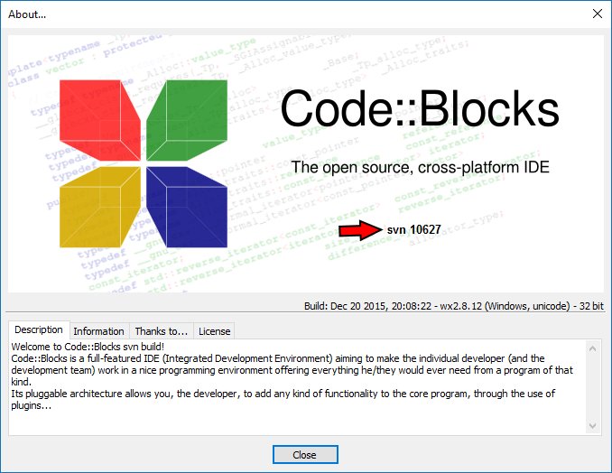

Tools :
We used an IDE named Code::blocks v.17.12 to implement, build and operate the code.
We took the help of C language to build our software project.

Slide 12
Overview of the Software :
The software we developed here is simple to use. Whenever the authority needs to calculate the customers total telephone bill of a specific month they just have to click the software icon. Then the software will ask them the required username and password. If the authority is legal they will enter the correct username and password and can get access to the main function of the software. The software then shows them the current time and date. Firstly, asking for the customer’s serial number, the program will gradually ask for customer’s name (3 strings), address (3 strings), telephone no, specific billing month. The date is automatically accepted. The software then asks for customers total call duration (Local, NWD and ISD) individually. After taking all data this program calculates them and shows the total Telephone costs of the customer of that month in a nice formation pattern. It is also be noted that, while calculating the total bill the program itself adds monthly rent of Tk. 100 and vat 30% in total cost of calculation. Finally we get the exact cost that the customer has to pay.

Slide 13
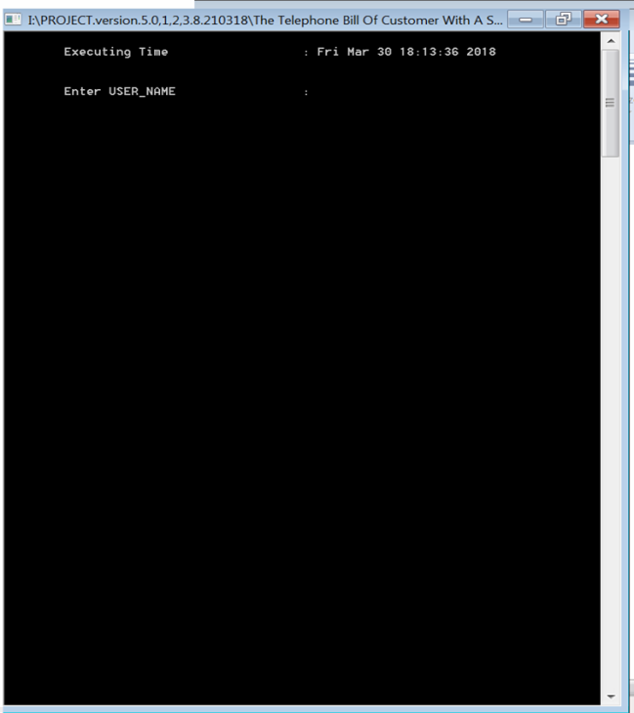
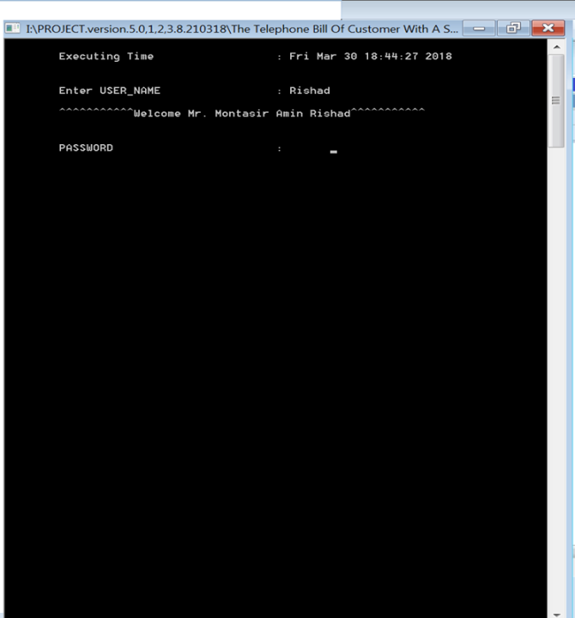
Overview of the Software (screenshots):
screenshot 1 screenshot 2

Slide 14
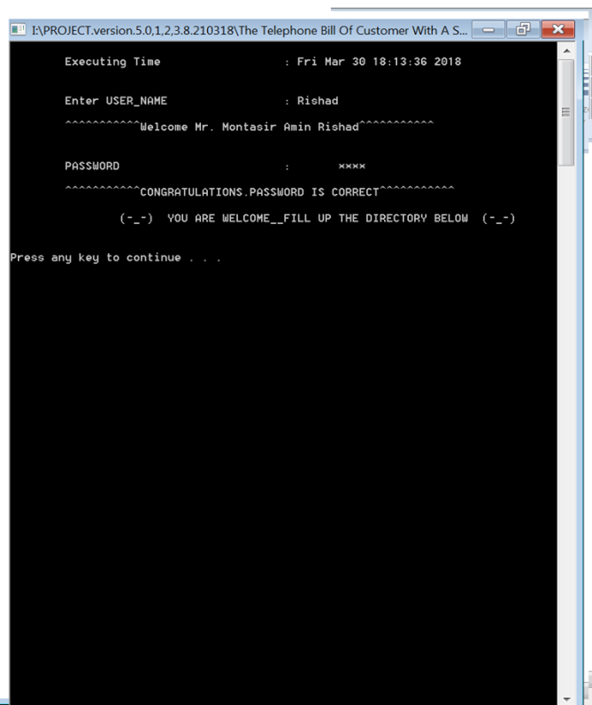
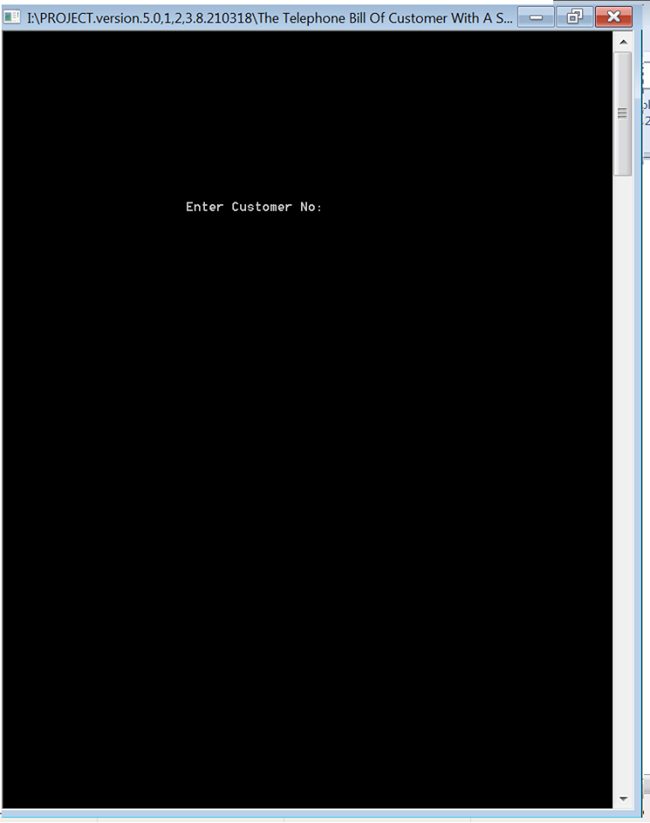
Overview of the Software (screenshots):
screenshot 3 screenshot 4

Slide 15
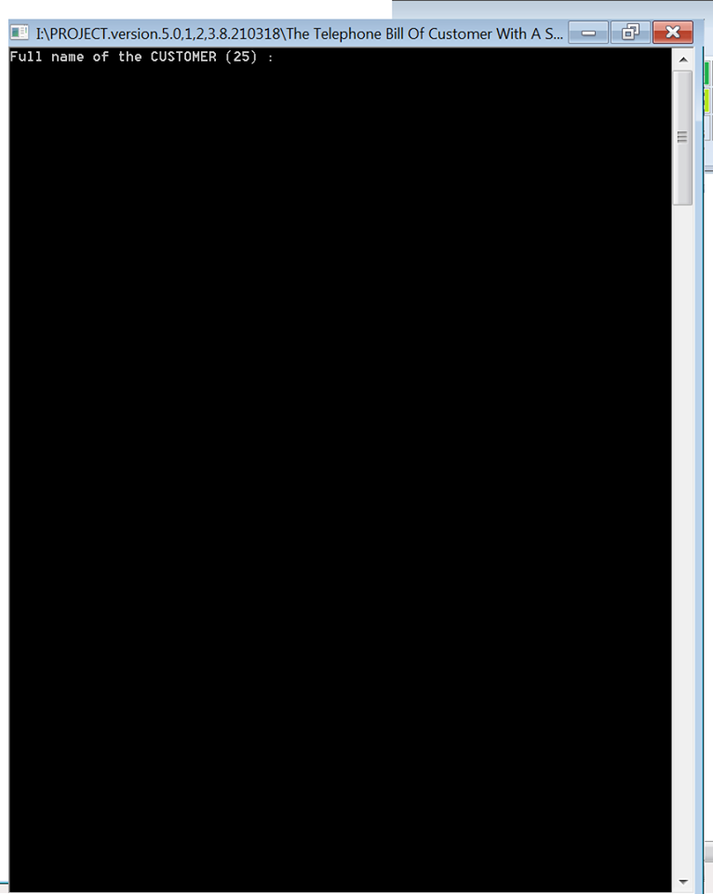
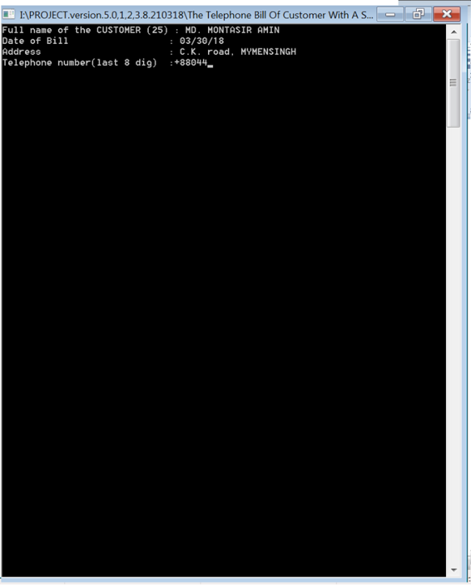
Overview of the Software (screenshots):
screenshot 5 screenshot 6

Slide 16
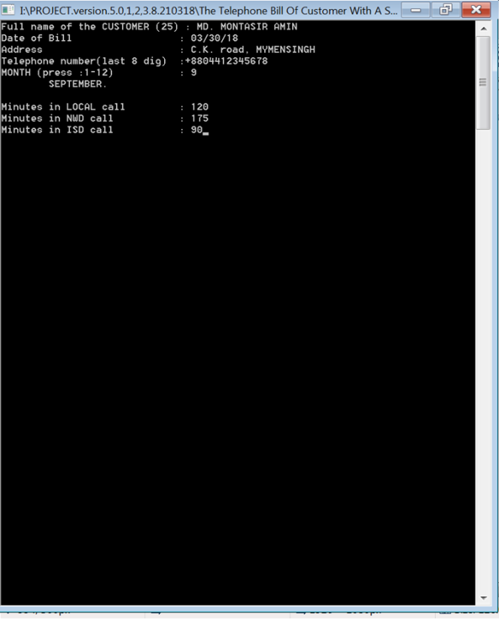
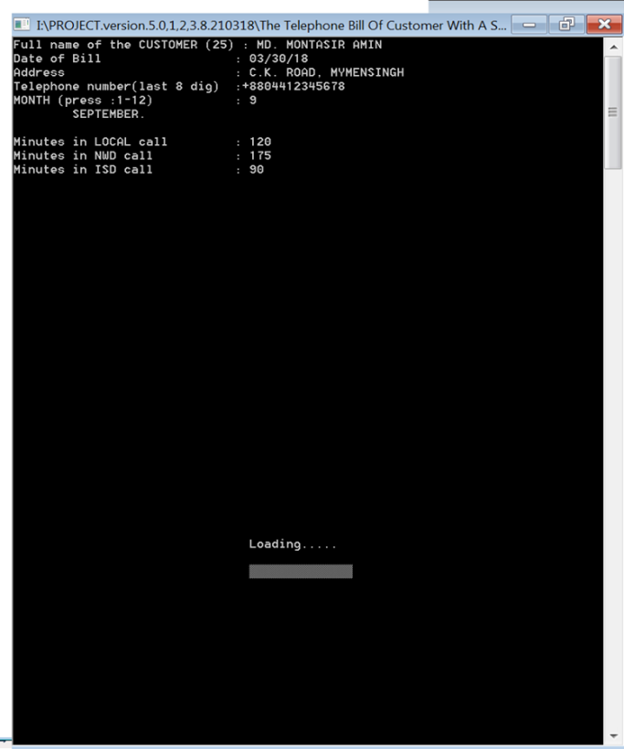
Overview of the Software (screenshots):
screenshot 7 screenshot 8

Slide 17
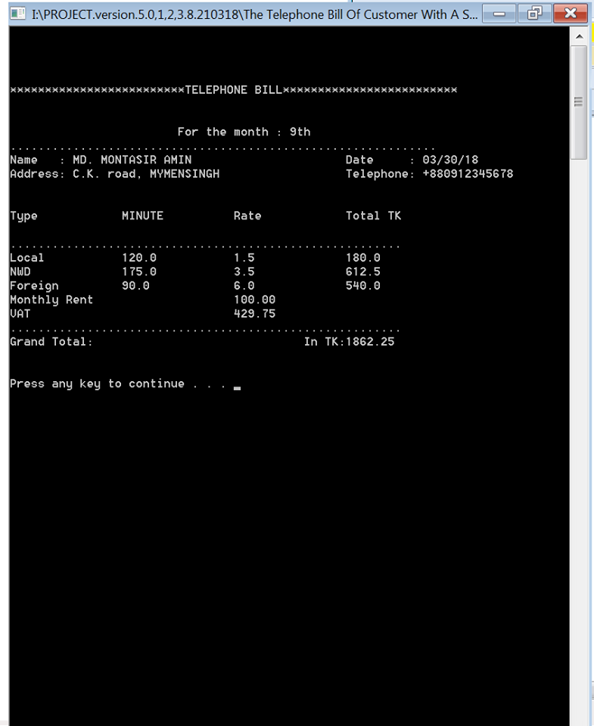
Overview of the Software (screenshots):
screenshot 9

Slide 18
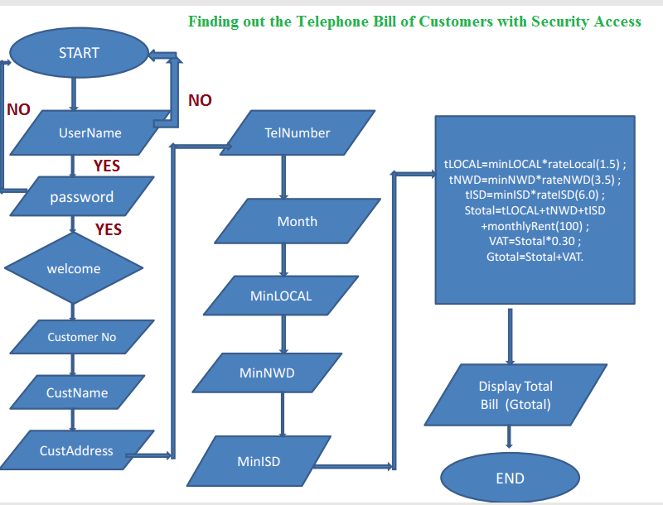
Flowchart :

Slide 19
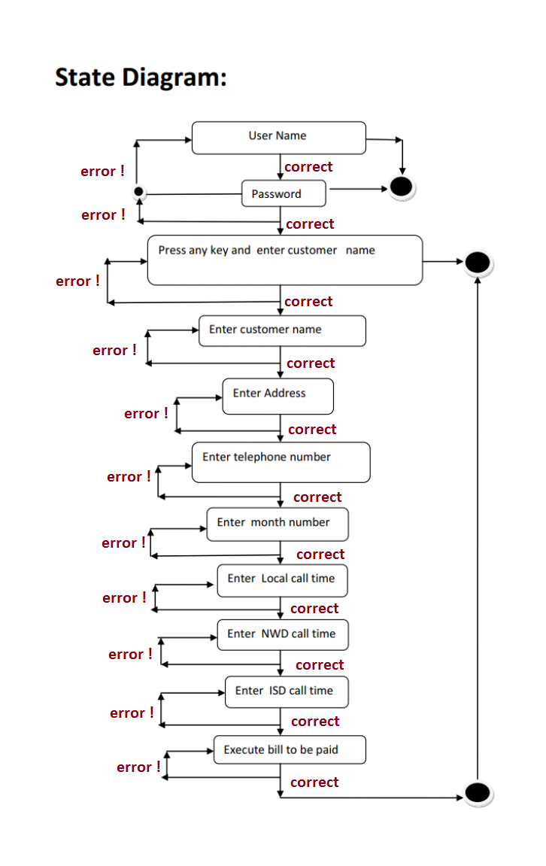
State Diagram :

Slide 20
Data Validation :
The software project also has the feature of data validation. That means whenever you enter any illegal data specially type mistakes it shows error and claims the correct information until it receives the legal data.

Slide 21


Limitations :
Though the project helps us calculating total bill and saves our time it has some limitations which are described below:
This software is unable to search customer’s name.
It can’t store a customer’s data in a file for the purpose of using them later.
The software is not build up as web connected so that someone can keep web contact through the software.

Slide 22
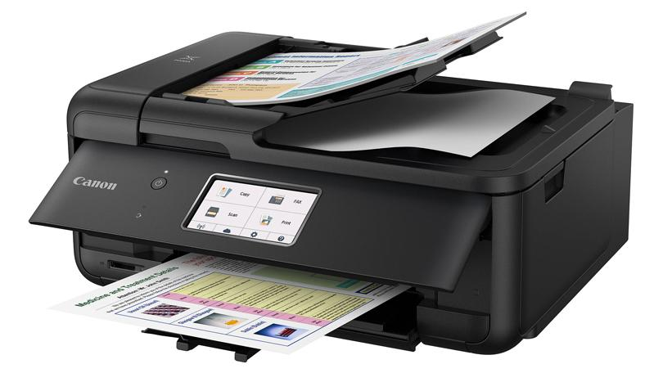

Further Development (future work):
Printer aided interface in this software so that authority can print out the copy of final bill report.
Also, we expect to add the facility for searching customer’s name and storing each customer’s all data and information in a file for the purpose of later of later use.
We also expect to add a web base interface in this software project so that one can directly connect to the authority through Web by the help of this software project.
A feature of data analytic.

Slide 23
Result and Discussion :
We tried to develop the efficient and advance software for calculating the monthly total Telephone bill of a customer. Our system can successfully do calculations and data validations for the customer. It has a very simplified and easy to use user interface. It is a console application and designed to support computer devices, it has different layout for devices having different screen sizes. It is kept secure with a username and default password. It has a nice and ordered architecture. It’s easily understandable and executable. It can save enormous amount of time and energy of the necessary calculations. Also, manual calculations are error prone which can be a great problem, but this system ensures error free calculations. Reports can be generated in seconds and invoice is created dynamically. Besides the existing features and functionalities, it will be more advanced as we have lots of features planned for further development.

Slide 24

CONCLUSION :
THANK YOU, TO ALL.. ☺ ☺ ☺

